Slide 1
Introduction to Money Laundering: Client’s Anti-Money Laundering Program
Client Name’s Payment Compliance Program

Slide 2

Narrator
(Looking for image)

Slide 3

What You Will Learn
Why do I need to learn about money laundering?
We’re a technology company!
Dangers of money laundering
How you can help protect our company from criminal activity

Slide 4


Placeholder. This is screen grab from Tour video
Need a Break Room or Lunch Room image.

Slide 6
What Is Money Laundering?
How Does It Put Us at Risk?
How Can You Help Prevent Money Laundering?

Slide 7
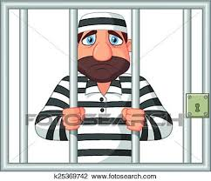
Image of lots of money
Image of criminals

Slide 8
You will be able to:
Define money laundering
Describe Client name’s role as a Payment Facilitator
Identify regulations that govern anti-money laundering programs
Explain why it’s important to “Know Your Customer”
Report unusual activity

Slide 9
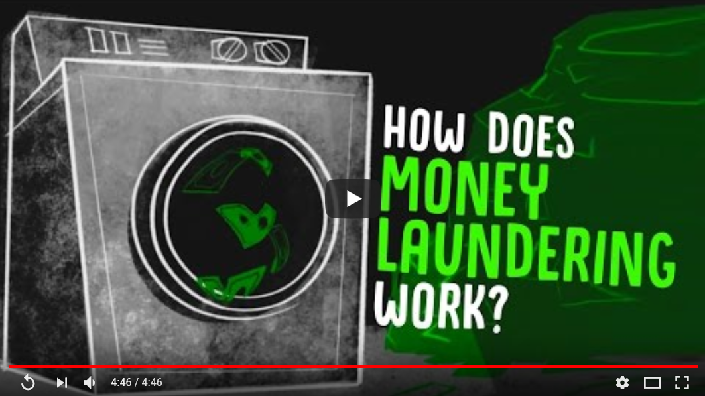
Placeholder for screen shots of course resources

Slide 10
Next Steps
Watch TED-ED YouTube video on Money Laundering

Slide 11

Introduction to Money Laundering: Client’s Anti-Money Laundering Program
Thanks for watching! ☺
Client Name’s Payment Compliance Program

